Slide 1
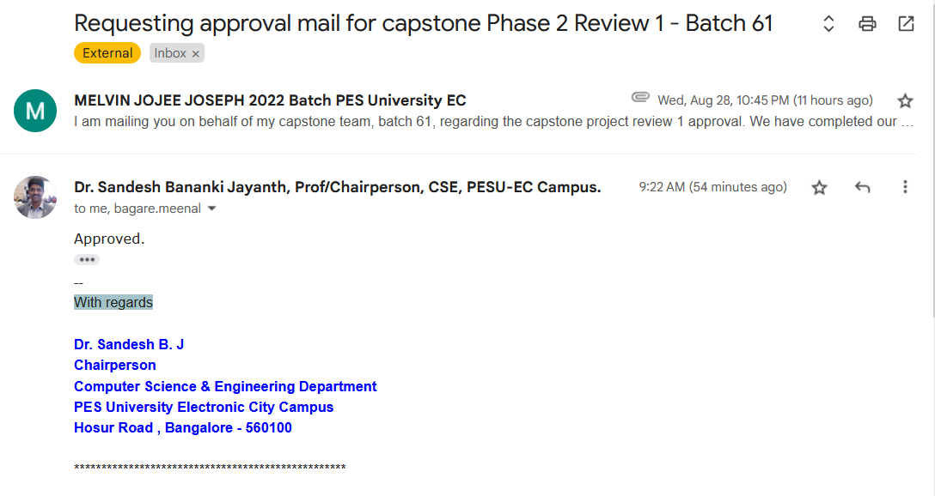

Slide 2
UE21CS461A – Capstone Project Phase – 2
Project Progress Review #1
Project Title : Indexing and Summarization of Sports
Videos using Multi-Modal Approach
Project ID : 61
Project Guide : Dr. Sandesh B J
Project Team : PES2UG21CS242 (Krupashree M V)
PES2UG21CS289 (Meenal Bagare)
PES2UG21CS294 (Melvin Jojee Joseph)
PES2UG21CS324 (Naveen Kumar Reddy G)

Slide 3
Outline
Abstract and Scope of the Project
Capstone Project Phase – 1
Summary of work (max 1 slide)
Inferences drawn from Literature Survey (max 1 slide)
Expected Deliverables( minimum 8 slides)
Gantt chart

Slide 4
Abstract and Scope
In today's fast-paced world, sports enthusiasts often struggle to find time to watch full-length games. Traditional sports video summarization methods rely on large editing teams to manually review game footage, select key moments, and compile highlights. This process is not only time-consuming and resource-intensive but can also result in uneven coverage of events.

Slide 5
Abstract and Scope
Our project aims to revolutionize the sports summarization process by leveraging a multi-modal approach that integrates:
Twitter Data: Analyzing audience reactions in real-time to identify significant moments.
Audio Features: Detecting audio cues like crowd roars or commentator excitement to pinpoint key events.
Video Content: Processing visual footage to capture and highlight critical moments.

Slide 6
Summary of Literature Survey in Phase 1
Research paper encompasses various approaches to video summarization and event detection across different sports, including baseball, soccer, cricket, and others.
Innovation techniques such as Multimodal Variational Autoencoder(Tl-MVAE), machine learning (YOLO v3 and OpenPose), LSTM with attention mechanism show promising result in accurately summarizing key event in sports video.
Challenges addressed include time-lags between events and tweets,enhance accuracy of action recognition and event detection in various sporting event.
Challenges in video summarization include data dependency, potential error in event detection,depend on data quality, and dependency on keyword frequency in text stream analysis.
These research papers collectively offer valuable insights into enhancing summarization accuracy, efficiency, and scalability in sports video analysis,highlighting areas for further exploration and improvement.

Slide 7
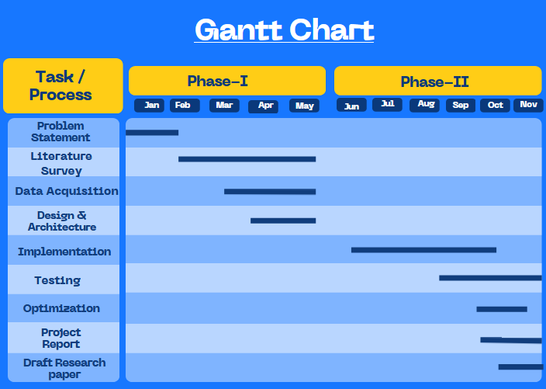
Capstone (Phase-I & Phase-II) Project Timeline

Slide 8
Contribution
Assigned with ScoreBoard extraction and analysis module.
Tasks completed-
Extracted the frames from the entire Soccer video. Implemented Tesseract module. Lines of code: 82 Time: 2 days
Implemented OCR to extract the Scoreboard information such as the score, team names and time. Lines of code: 171 Time: 1 week
Researched and started implementing the method to extract the scoreboard information dynamically using Yolo v7.
Time: 1 week

Slide 9
Contribution
Assigned with commentary module.
Tasks completed-
Utilised OpenAI’s Whisper model in order to extract commentary from the videos. Lines of code: 60 Time: 3 days
Implemented an SVM model for football event classification based on commentary. Lines of code: 100 Time: 1 weeks
Fine tuned Bert model for football event classification based on commentary.
Lines of code: 80 Time: 1 weeks

Slide 10
Contribution
Assigned with twitter module for timestamp extraction.
Tasks completed-
Collected and filtered twitter data . Lines of code: 78 Time: 2 days
Analyzed and visualized tweet data to identify trends and peaks.
Extracted retweet (RT) timestamps for peaks occurring every 2 minutes for further analysis.
Lines of code: 110 Time: 2 weeks

Slide 11
Contribution
Assigned with audio module for crowd noise peak timestamp extraction.
Tasks Completed:
1.Extracted the Audio from the video using ffmpeg library and
Lines of code:42 Time: 1 Day
2.Visualization of the audio spectrogram and Zero_crossing Over time(ZCR),
Envelope feature,Finding Peaks using RMS intensity.
Lines of Code:57 Time: 1 Day
3.Visualization of the peaks in the combined audio of commentator and crowd
for peak timestamps.
Lines of Code:45 Time: 2 Days

Slide 12
Contribution
Tasks Completed.
4.Separated the Commentary audio and Crowd noise for efficient detection of
event through only the crowd noise.
Lines of Code:76 Time: 3 Days
5.Visualized the Peaks Using only the Crowd noise and Experimented with the
Cut-off Peak Values to efficiently Detect the Key events.
Lines of Code:41 Time: 5 Days
6.Researched On mapping of peak timeStamps from Crowd Noise to commentary
for event annotation Using the Transcription of the commentary at that time
span.
Time:2 Weeks

Slide 13
Technologies Used So Far
Google Colab
Visual Studio Code
OpenAI Whisper
Bert Model from Hugging Face
Sklearn for SVM model
Tesseract Open Source OCR Engine
OpenCV
Yolo v7
OIDv4 ToolKit

Slide 14
References
Baseball Videos via a Time-Lag-Aware Multimodal Variational Autoencoder. Sensors (Basel). 2021 Mar 14;21(6):2045. doi: 10.3390/s21062045. PMID: 33799412; PMCID: PMC7999231.
A. Javed, K. B. Bajwa, H. Malik and A. Irtaza, "An Efficient Framework for Automatic Highlights Generation from Sports Videos," in IEEE Signal Processing Letters, vol. 23, no. 7, pp. 954-958, July 2016, doi: 10.1109/LSP.2016.2573042
H. Sattar, M. S. Umar, E. Ijaz and M. U. Arshad, "Multi-Modal Architecture for Cricket Highlights Generation: Using Computer Vision and Large Language Model," 2023 17th International Conference on Open Source Systems and Technologies (ICOSST), 2023, pp. 1-6, doi: 10.1109/ICOSST60641.2023.10414235
Z. Saeed, R. Ayaz Abbasi, M. I. Razzak and G. Xu, "Event Detection in Twitter Stream Using Weighted Dynamic Heartbeat Graph Approach [Application Notes]," in IEEE Computational Intelligence Magazine, vol. 14, no. 3, pp. 29-38, Aug. 2019, doi: 10.1109/MCI.2019.2919395

Slide 15
References
5 . Raj, R., Bhatnagar, V., Singh, A. K., Mane, S., & Walde, N. (2021, January 21).
Video Summarization: Study of various techniques. arXiv.org. https://arxiv.org/abs/2101.08434
6 . Video Summarization Study Of Various Techniques Proceedings of IRAJ International Conference,26th May, 2019
7. Z. Saeed, R. Ayaz Abbasi, M. I. Razzak and G. Xu, "Event Detection in Twitter Stream Using Weighted Dynamic Heartbeat Graph Approach [Application Notes]," in IEEE Computational Intelligence Magazine, vol. 14, no. 3, pp. 29-38, Aug. 2019, doi: 10.1109/MCI.2019.2919395

Slide 16
Thank You

